Slide 1

SOCIAL MEDIA 101
designed to inform parents & students
Safety | Integrity | Professional | Data Informed | Innovative | It’s not just school. It’s LIFE.

Slide 2

WHAT ARE students USING?
What apps and social media sites are students using?
Do you know what the icons for these apps look like?
Safety | Integrity | Professional | Data Informed | Innovative | It’s not just school. It’s LIFE.

Slide 3


WHAT ARE THEY USING?
Instagram, Vine, YouTube, Snapchat, Twitter,
Kik, Facebook, tumblr, hot or not, Calculator Percent
https://youtu.be/6fT5VsddNlg
Wanelo, Ooovoo, Yik Yak, Whisper, Google+, Omegle, Chatroulette
Safety | Integrity | Professional | Data Informed | Innovative | It’s not just school. It’s LIFE.

Slide 4
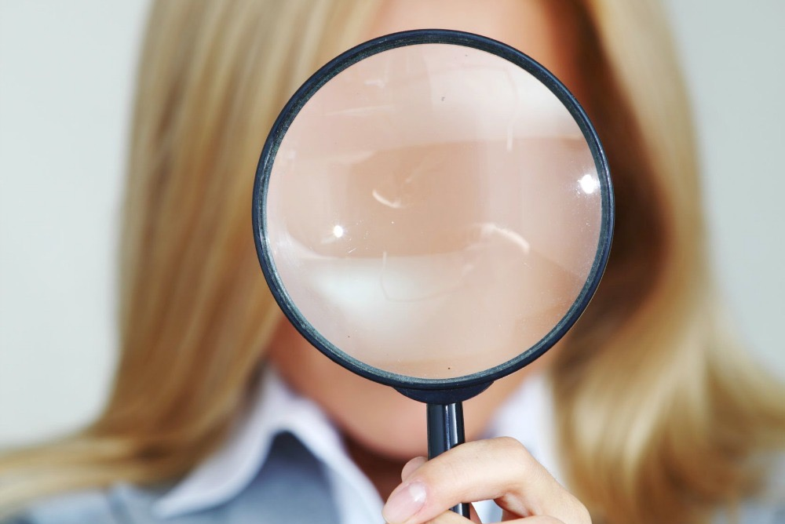
SET GUIDELINES AND CHECK OFTEN!
Monitoring your kids online activity is not spying, it’s parenting.
Safety | Integrity | Professional | Data Informed | Innovative | It’s not just school. It’s LIFE.
Notes:
Setting guidelines for what kinds of things are options for posting and which are not is important. THINK…Is it TRUE? Is it HELPFUL? Is it INSPIRING? Is it NECESSARY? Is it KIND?

Slide 5
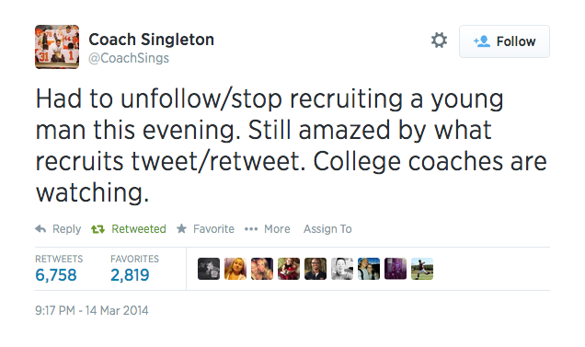
CONSEQUENCES…
Safety | Integrity | Professional | Data Informed | Innovative | It’s not just school. It’s LIFE.
Notes:
It is crucial for students to understand the consequences for this sort of social media presence. This kind of representation will effect ALL athletes (HS & College), any scholarship receiving students, and any students who are “friends” that can and will pass this information along (that would be EVERYONE).

Slide 6
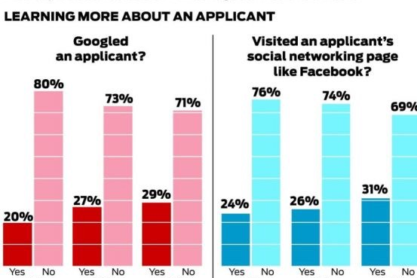
post-secondary consequences
Safety | Integrity | Professional | Data Informed | Innovative | It’s not just school. It’s LIFE.
Notes:
Post- Secondary institutions are using social media more and more as a tool to help weed out “trouble-making” students. It is estimated that within the next 5 to 10 years, each college campus will have a dept. solely dedicated to checking the social media activity of students before accepting or denying them. This will especially be true for ANY scholarship-awarded students.

Slide 7

CYBERBULLYING
Safety | Integrity | Professional | Data Informed | Innovative | It’s not just school. It’s LIFE.
Notes:
My generation, as the ones before me, were brought up with more of a face-to-face concept of relationship and way of socializing. These kiddos post what they are EATING, which teachers they love or hate, who their BFF’s were yesterday, who they liked TODAY, and who they will LOVE tomorrow. Kids are prone to this form of bullying because it isn’t face-to-face. Their courage is up and they believe their chances of getting caught go down due to anonymity. The chance of your student succumbing to this form of punishment goes down when parents remain involved in their child’s social media activity.

Slide 8

Other Consequences
Lack of Concentration
Lack of Human Interaction
Distorted Reality
Addiction
Safety | Integrity | Professional | Data Informed | Innovative | It’s not just school. It’s LIFE.
Notes:
It has been proven that Kids who check their social media activity within 15 spans get lower grades.
Lack of social skills/ Lonely
Post how you WANT to appear and be seen…not real
Psychologists are actually seeing students now for technology and social media addiction

Slide 9
suggestions for parents/guardians
Keep the computer in a high-traffic area of your home and implement safety filters.
Maintain tech free bedrooms.
Charge phones in parents room overnight.
Know your child’s passwords.
Frequently access their technology devices.
Establish limits and continually dialogue with your children about online safety.
Safety | Integrity | Professional | Data Informed | Innovative | It’s not just school. It’s LIFE.

Slide 10



free Apps for parents
Secure Teen Parental Control
Screen Time Parental Control
Kids Place- Parental Control
Safety | Integrity | Professional | Data Informed | Innovative | It’s not just school. It’s LIFE.

Slide 11
Thank you for listening.
This presentation can be found on
LIFE Middle school WAXAHACHIE’s website.
Safety | Integrity | Professional | Data Informed | Innovative | It’s not just school. It’s LIFE.

