Slide 1

Life High School Waxahachie

Slide 2
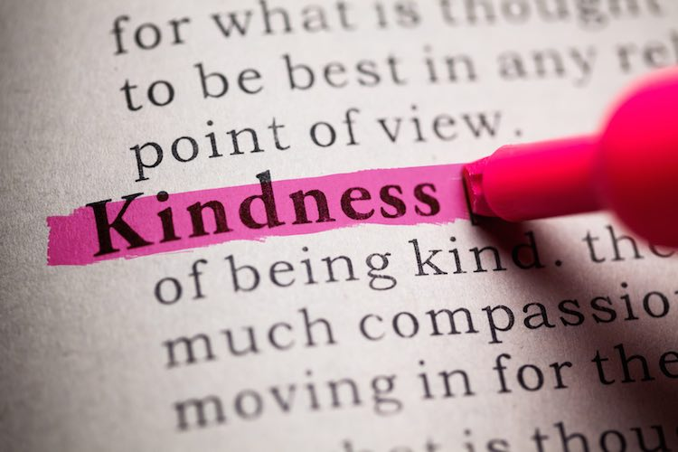
The quality of being friendly, generous, and considerate.
A kind act.
Synonyms: affection
warmth
gentleness
concern
care
Please click and watch:
The Consequences of Words Video

Slide 3
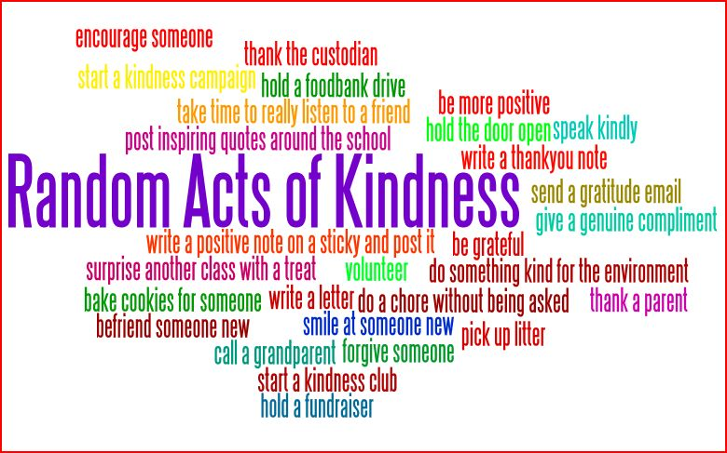
A selfless act performed by a person or people wishing either to assist or to cheer-up an individual or people.
Class Discussion:
What are five other examples of Random Acts of Kindness?
Can you think of a few people who would really benefit from these kind actions?

Slide 4
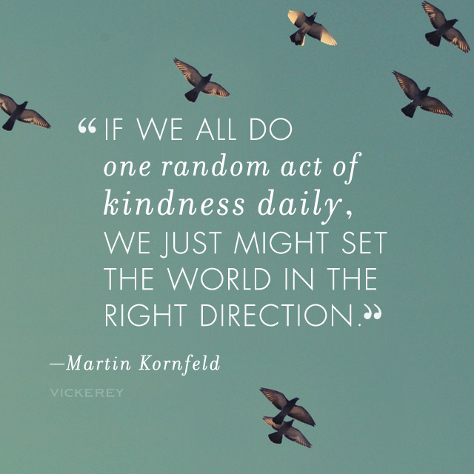
As a class, please discuss the following questions…
1. What are your thoughts about this quote? Do you think it could be true?
2. What does a Random Act of Kindness (RAK) do for the person receiving the act? What about the person performing the RAK, what does it do for them?
3. What sort of changes might we notice in the world if this trend of random acts of kindness were to catch on?

Slide 5
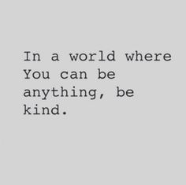
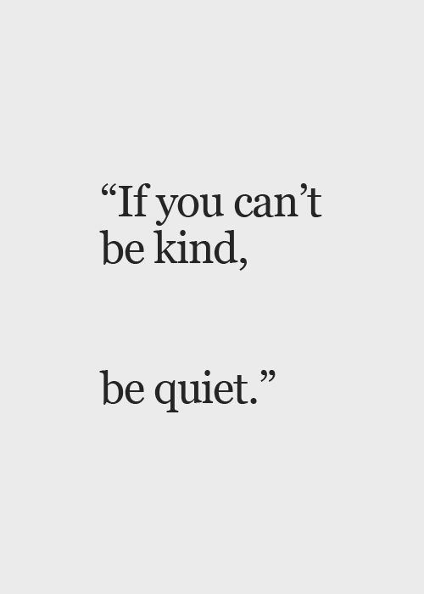

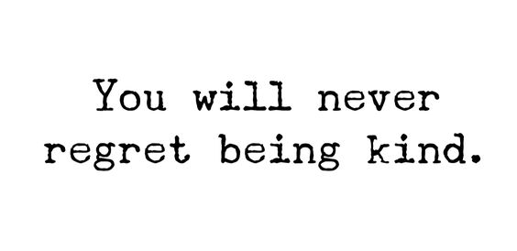



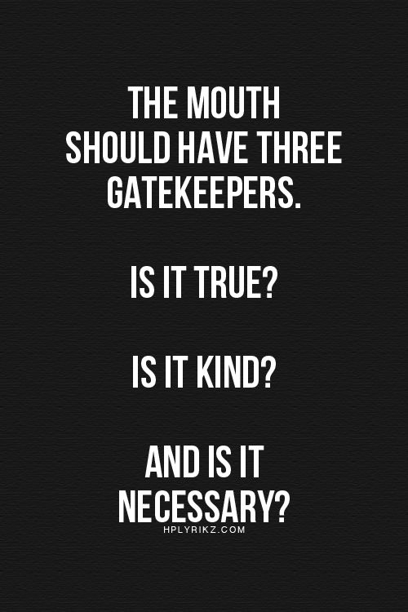
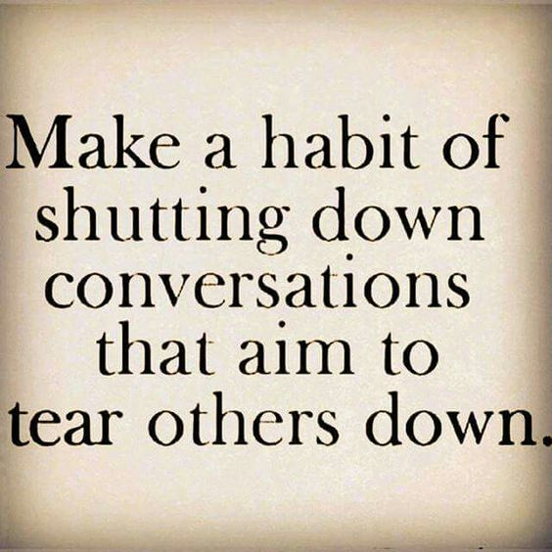

CHALLENGE: Perform one Random Act of Kindness each day for a full week.

